Slide 1
Supervised Machine Learning - Intro
Prof. Sebastián Vallejo Vera

Slide 2
In Week 5 we talked about Scaling and Topic Modeling, and in Week 7 we talked about Word Embeddings.
All of these techniques fall within that category of unsupervised learning. Why unsupervised? Well, because we make certain assumption about the data generating process, then allow the machine the order the data based on those assumptions, and then we imposed meaning to the order.

Slide 3
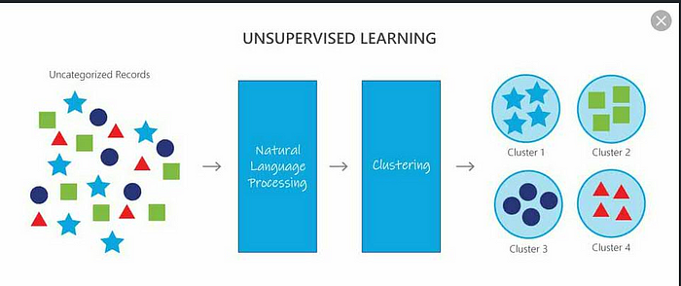

Slide 4
In Week 5 we talked about Scaling and Topic Modeling, and in Week 7 we talked about Word Embeddings.
All of these techniques fall within that category of unsupervised learning. Why unsupervised? Well, because we make certain assumption about the data generating process, then allow the machine the order the data based on those assumptions, and then we imposed meaning to the order.
In the next couple of weeks, we will be learning about another approach: supervised machine learning (SML).

Slide 5

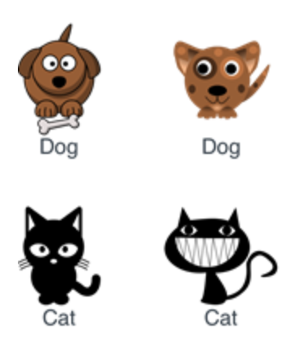
Labeled Data
Black Magic
Prediction
It’s a dog!
or
It’s a cat!

Slide 6
Labeled Data
Black Magic
Machine Learning Models
Prediction
It’s a dog!
or
It’s a cat!

Slide 7
Barberá et al. (2021) provide an excellent guide for supervised text classification. They identify three steps required for SML. I will create a modified version of this:
Select a corpus
Create a training set
Choose and train an ML model
VALIDATE!
Let’s start!

Slide 8
1) Choose a Corpus

Slide 9
The choice of the corpus depends on the research question. What is the universe, or source, of text?
It can be well-defined, and small: speeches from the Canadian Parliament between 2000 and 2019.
It can be broader: media headlines between 2000 and 2019.
If the researcher has access to the universe of texts, then the decision is straightforward: that is your corpus.
If the researcher does not have access to the universe of texts then…

Slide 10
What is the preferred sampling strategy?
As researchers, we want a corpus the mimics the population. You want to include relevant objects (minimize false negatives) and exclude irrelevant objects (minimize false positives). Irrelevant texts will add noise to the final analysis and will add cost to the production of your training set.
Researchers also need to wary about representation.
You want to maximize relevance and representation.

Slide 11
What sampling strategy to use when selecting a corpus?
According to Barberá et al. (2021) suggests using keyword search over topic search. However, it can vary by case, and, at the end of the day, what you want to avoid, as with any sample, is selection bias.
For a more detailed explanation, see Barberá et al. (2021), p. 20-24.

Slide 12
2) Creating a Training Set

Slide 13
There are crucial decision that the researcher need to make when building their training set:
Unit of analysis.
Note that the UoA does not need to necessarily correspond to the UoA of your final dataset.
Sampling procedure.
Categories and number of observations.
Coders.

Slide 14
Unit of Analysis
When deciding on the UoA, think about the following questions:
What am I trying to identify in the text?
Can my category of analysis change throughout the text?
There are assumptions that you are making about this depending on the model you choose.
If it changes, am I interested in an aggregated element? Would I prefer the disaggregated chunks?
How much noise am I adding by choosing a longer UoA?
How much information am I losing by choosing a shorter UoA?
What is the optimal UoA for me (as a human coder) to identify the element that I am interested in?

Slide 15
Sampling procedure
So, you have one million speeches/tweets/manifestos/answers/etc. Should I randomly sample N documents and code them?
As always, it depends. When we are training an ML model, we are showing it some data. For the ML model, that is the world it knows.
If you tell the model that in the world there are either cats or dogs, and you show it a parrot, it will try to fit the parrot within the categories it knows (cats or dogs).
But also, if you show it a lion (which you would have categorized as a cat), and it has never seen a lion before, it will have a hard time deciding
Thus, your sample should be both, representative of the categories to be predicted, and of the different ways each category can be present in your sample.

Slide 16
What if my categories are ‘naturally’ unbalanced (i.e., the distribution of categories in a dataset are not uniform)? Should I oversample the smaller category? Should I undersample the larger category? Should I maintain an unbalanced dataset?
According to Mohammed et al. (2020), you get better results by oversampling (and this has been my experience as well). Regardless of the route you choose, you always need to validate your results.

Slide 17
Categories and number of observations
How many categories should I choose? The straightforward answer is as many as you need.
BUT, and this is a theoretical but, always consider whether the categories exclusionary.
For machines, as well as for humans, dichotomous categories are easier to predict than multinomial categories. If theoretically plausible, try to have dichotomous training sets (or training sets with few categories).*

Slide 18
The number of observations in your training set will depend on the complexity of the task and the ML model you are using (more on this later).
However, Kaufman (2024) propose a method to select more informative training sets with fewer observations that achieve similar performance than randomly sampled training sets.

Slide 19
coders
Now that you have a training set, you need to get some coders.
Barbera et al. (2021) suggest:
More Unique Documents (thus fewer coders per document): More information in the training dataset, and thus better performance of the classifier.
More Coders per Document (thus coding fewer unique documents): Allows identification of better/worse coders.
But ultimately: For any fixed number of total codings, maximize the number of unique documents coded.

Slide 20
3) Choose and train an ML model

Slide 21
In Weeks 8 to 9 we will learn about the following:
Support Vector Machine (SVM)
Bidirectional Long-Short Term Memory (Bi-LSTM) models.
Transformers-based ML models.
Why you should probably go directly to https://huggingface.co/ for all your SML needs.

Slide 22
4) Validate

Slide 23
Once you have trained your model, you will be able to test it. The first and second performance statistics will come from the training set itself (training and test set; cross-validation). We will also learn how to validate
The third validation comes from outside the training set (out-of-sample validation).

